Slide 1
Natural Language Processing
Week 10

Slide 2
Good evening, everyone. Welcome to the live session.
Today, we will be practicing problems from the current week’s content.
We will wait 5 minutes for everyone to join in and start at 7:05 pm.

Slide 3
Question 1. Different phases of entity linking are -
A) Candidate Selection -> Reference Disambiguation
B) Reference Disambiguation -> Candidate Selection -> Mention Identify
C) Mention Identify -> Candidate Selection -> Reference Disambiguation
D) All of the above

Slide 4
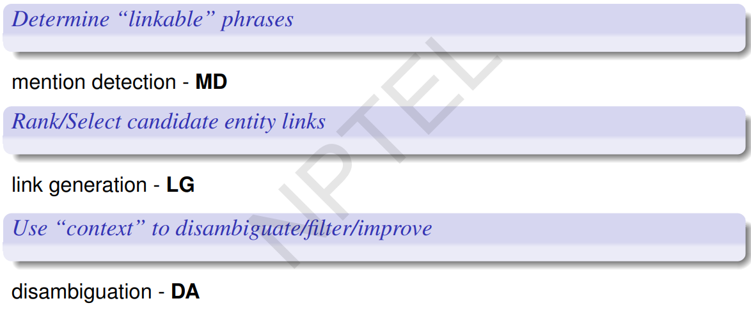
Solution
Answer: C
Mention Identify -> Candidate Selection -> Reference Disambiguation

Slide 5
Question 2. The text span s = “Sea” occurs in 600 different Wikipedia articles.
c1 223
c2 161
c3 18
c4 11
No Link 187
Calculate the keyphraseness of “Sea”.
A) 0.232
B) 0.886
C) 0.688
D) 0.976

Slide 6
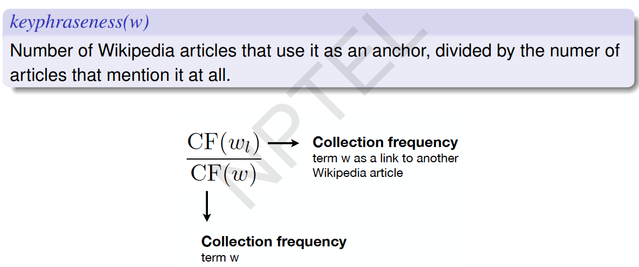
Solution
C) CF(si) / CF(s) = 223 +161+18+11 / 600 = 413 / 600 = 0.688

Slide 7
Question 3. What is the commonness of (s, c2) in the previous question?
A) 0.765
B) 0.389
C) 0.145
D) 0.910

Slide 8
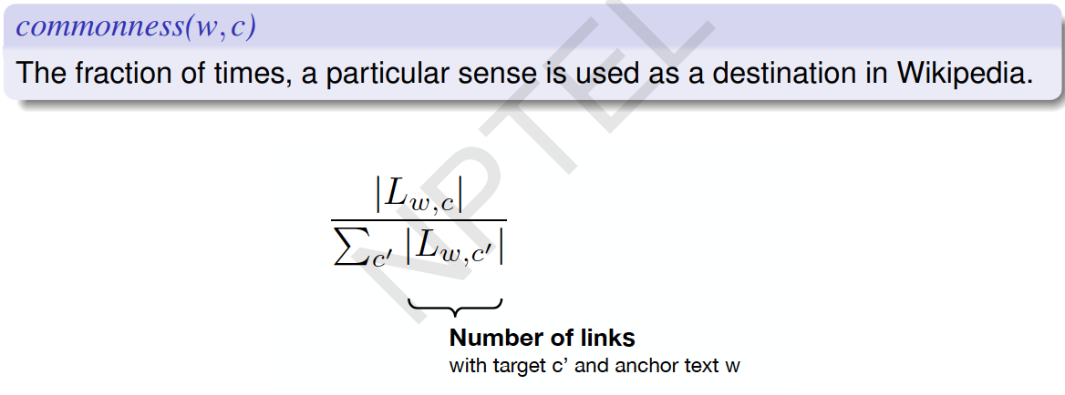
Solution
B) 161/(223+161+18+11) = 161/413 = 0.389

Slide 9
Question 4. Relevant feature/s for a supervised model for predicting the topics to be linked is/are:
A) Disambiguation Confidence
B) Relatedness
C) Link Probability
D) All of the above

Slide 10
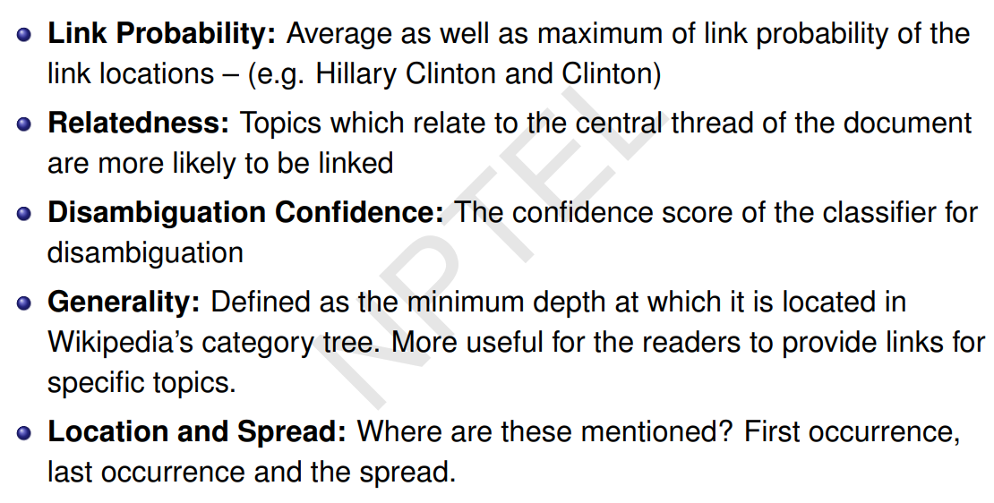
Solution
Answer: D

Slide 11
Question 5. Which of the following problem exists in bootstrapping technique for Information extraction are:
A) Sensitiveness towards the seed set
B) High precision
C) Less manual intervention
D) All of the above

Slide 12
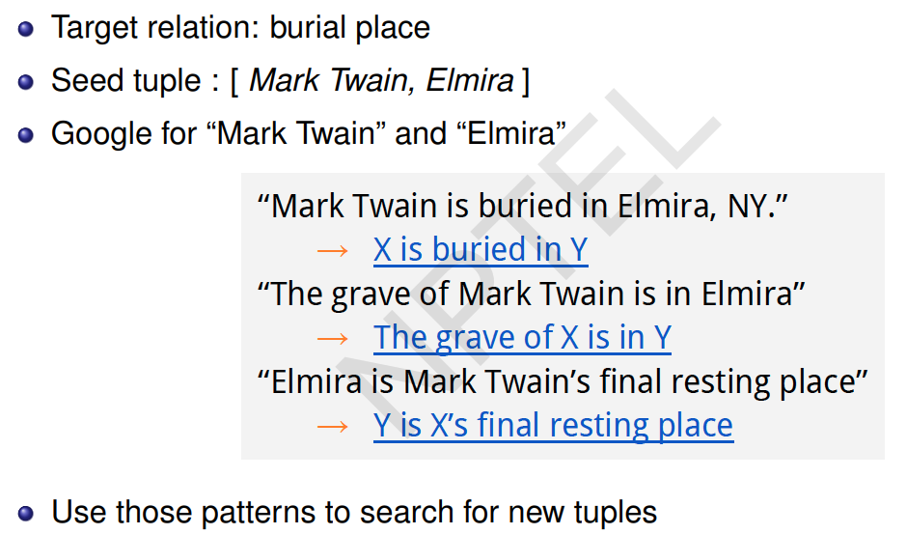
Solution
Answer: A

Slide 13
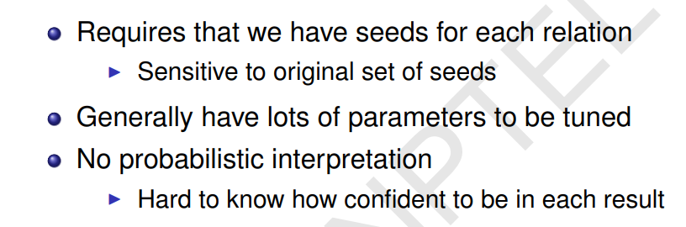
Bootstrapping problems

Slide 14
Question 6. Which of the following is an advantage of unsupervised relation extraction:
A) Can work efficiently with small amount of hand-labeled data
B) Not easily generalizable to different relations
C) Need no training data.
D) Always perform better than supervised techniques.

Slide 15
Solution
Answer: C

Slide 16
Question 7. Which of the following is not a Hearst’s Lexico Syntactic Patterns for automatic acquisition of hyponyms -
A) X or other Y
B) X and other Y
C) Y including X
D) X but not Y

Slide 17
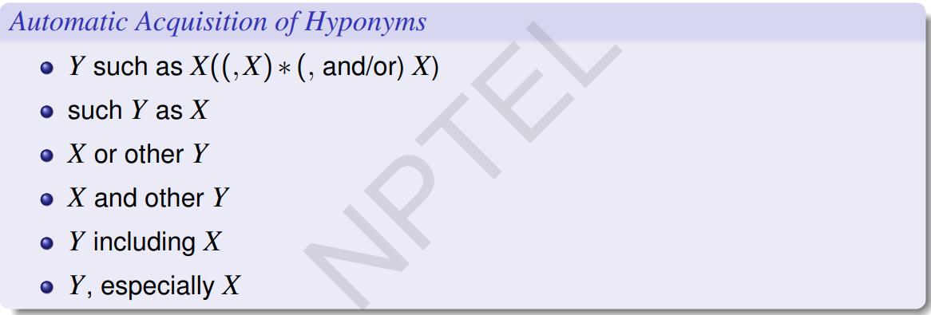
Solution
Answer: D

Slide 18
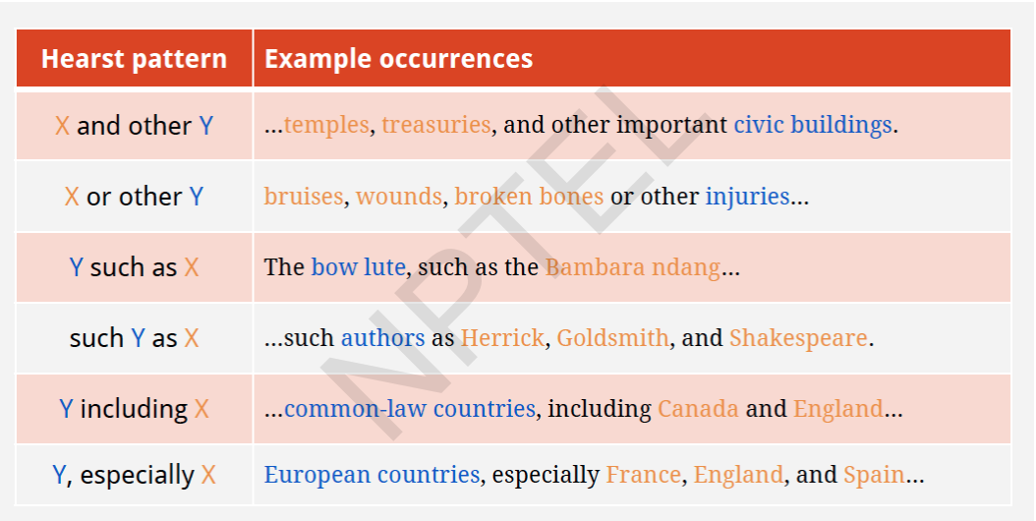

Slide 19
Question 8. Advantage of Distant supervision over bootstrapping method
A) Need more data
B) Less human effort
C) Can handle noisy data better
D) No Advantage

Slide 20
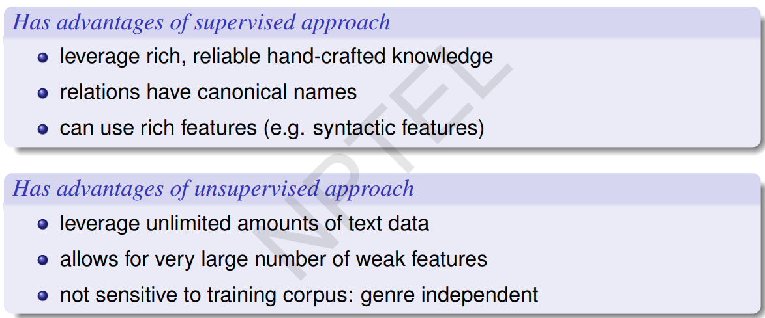
Solution
Answer: C

Slide 21
Question 9. Consider a dataset with a very low number of relations - all of which are very important. For a relation extraction task on that dataset, which of the following is the most useful metric
A) Precision
B) Recall
C) Accuracy
D) F1-Score

Slide 22
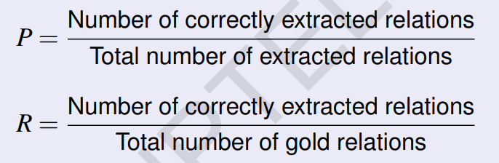
Solution
Answer: B

Slide 23
Question 10. What is KeyPhraseness (wikipedia)?
A) Number of articles that mention a key phrase divided by the number of wikipedia articles containing it.
B) Number of Wikipedia articles that use it as an anchor, divided by the number of articles that mention it at all.
C) Number of articles that mention a key phrase times by the number of wikipedia articles containing it.
D) Number of Wikipedia articles containing the key phrases times by number of articles mentioning it.

Slide 24
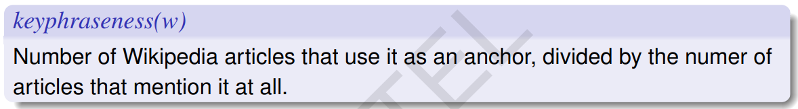
Solution
Answer: B

